Slide 1
Learning Intent with Click Data
Dublin Machine Learning

Slide 2
Google Deep & Wide
https://arxiv.org/abs/1606.07792
we present Wide & Deep learning---jointly trained wide linear models and deep neural networks---to combine the benefits of memorization and generalization for recommender systems. We productionized and evaluated the system on Google Play, a commercial mobile app store with over one billion active users and over one million apps. Online experiment results show that Wide & Deep significantly increased app acquisitions compared with wide-only and deep-only models. We have also open-sourced our implementation in TensorFlow.
https://www.tensorflow.org/tutorials/wide_and_deep

Slide 3
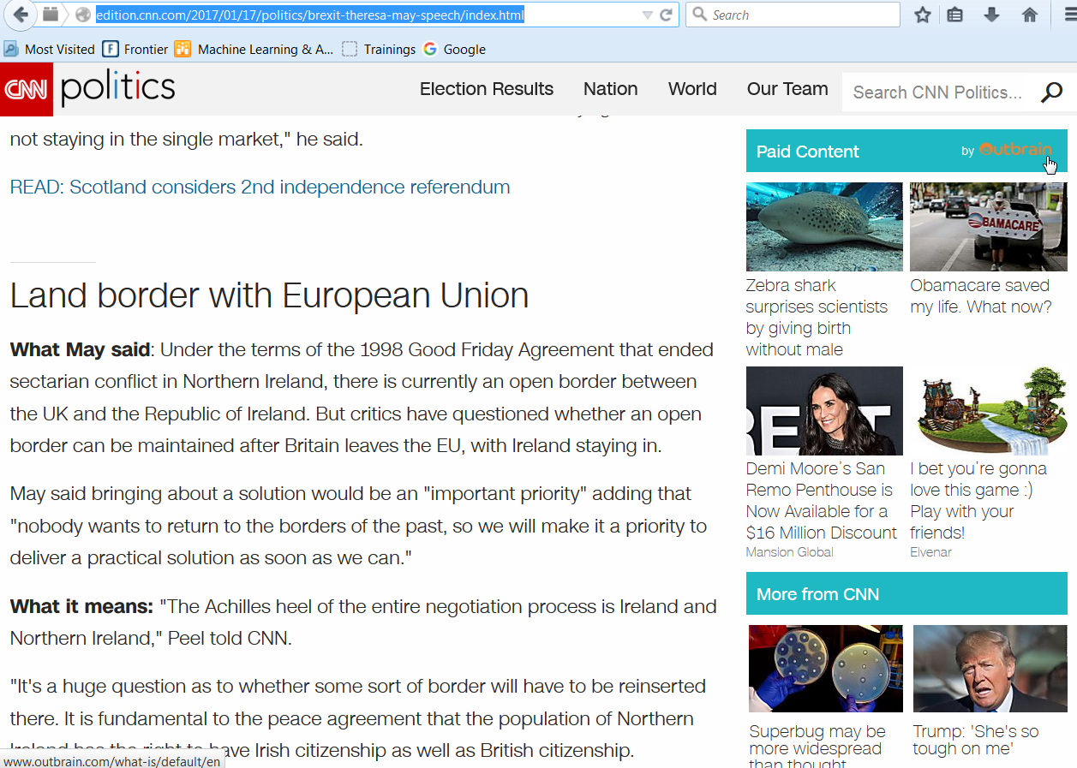
User Intent

Slide 4
Learning User Preferences
Default landing screen
ML Ranked Preferences
Personalized landing screen
Ad #1
0.20
Ad #3
Ad #2
0.14
Ad #1
Ad #3
0.64
Ad #2
Ad #4
0.02
Ad #4

Slide 5
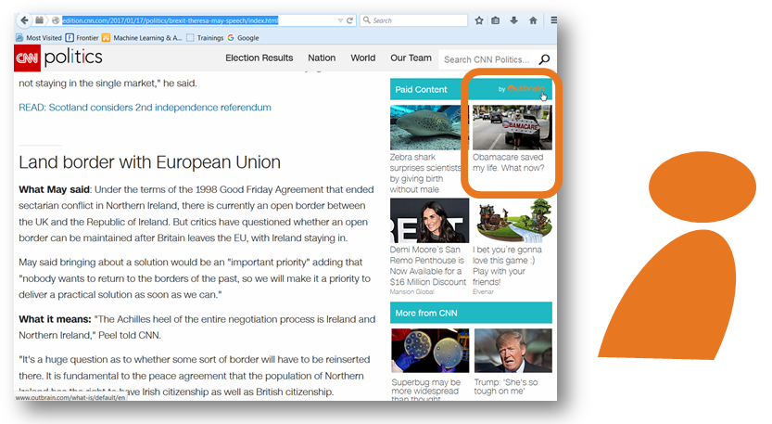
Determinants of taken action.
Competing ads
Advert
Document
User
Session
Event

Slide 6
Determinants of taken action.
Ad ID
Ad URL
On page ad count
Competing ad docs
Ad Category, Ad Site
Document URL
Category
Domain name
Publish date
User ID
Last page visited
Current session page views
All pages views
Historical ad clicks
Time in current session
Plan type
Previous claim types
….
Event hour
Event day
Device type
User Country
User Region

Slide 7
Online Learning
Mostly categorical data
Big Data (10M+ events)
Dynamic Features
Matrix Factorisation
+ Fast
+ Low memory consumption

Slide 8




Open Source Matrix Factorisation
FFM
Field Aware Factorised Machines
FM
Factorised Machines
FTRL
Follow the Regularised Leader
LibFFM
Libtools from National Taiwan Univeristy
http://hunch.net/~vw/
https://www.csie.ntu.edu.tw/~cjlin/libffm/
http://bit.ly/2jVxM81

Slide 9
Characteristics of Matrix Factorisation models
Feature Hashing
Online Learning
Field Aware Learning
Handles Big Data
Speed, Low Memory
Granular

Slide 10
Feature (Feature Hash Trick)
The feature hash trick allows us fit all features (eg. URLs) within a defined space and allow unknown new features to be easily added in the future.
Hash each document to get it’s unique integer feature representation
Modulos of our a desired bit rate allows this unique number fit within a given range (eg. 2^24 or 16777216)
(Remainder of 1721850226 divided by 16777216,
eg. 11 % 3 = 2)
Training feature space is 2^24 wide
X
Virtual Training Data Table
10574194

Slide 11
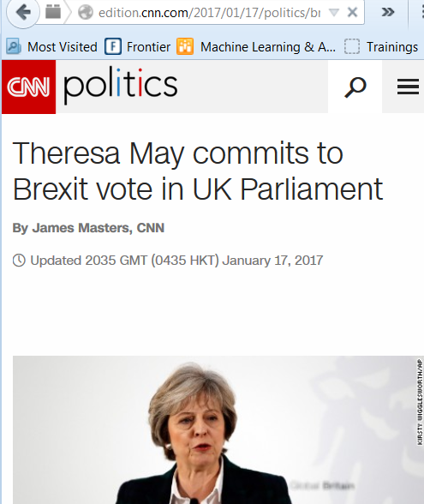
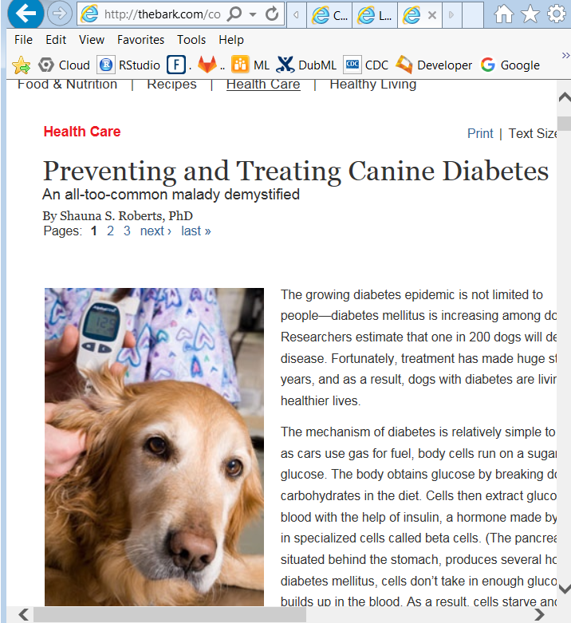
Feature Interactions

Slide 12
Online Learning
Stage training data on disk
Read in single action (or non action) at a time
Hash each attribute of that click
Use learning algorithm to update each hash value.
Move to next line on file (if at end of file, optionally make multiple passes of file)
Benchmark : 6 million rows (5GB file) train, 4 million predicted on HP840 G3 (UHG standard laptop) in approx 40 mins

Slide 13
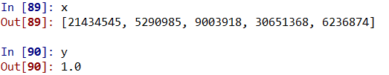
Online Learning
Stage training data on disk
Read in single action (or non action) at a time
Hash each attribute of that click
Use learning algorithm to update each hash value.
Move to next line on file (if at end of file, optionally make multiple passes of file)
clicked “yes”
hashed user features

Slide 14
Field aware features
Consider the following example,
Note that “user”, “offers accepted” and “url views” are categorical and “premium” is numerical.
click | user | prescription | url views | premium
no | dhanley2 | “Generic methylphenidate” | uhc.com/policy-terms/5.6 uhc.com/provider-search … | $2299
http://www.csie.ntu.edu.tw/~r01922136/slides/ffm.pdf

Slide 15
Field aware feature mapping
Field Name | Field Index | Feature Name | Features Index
user | field 1 | user-dhanley2 | feature 75407
prescription | field 2 | prescription-“generic methylphenidate” | feature 8964
url views | field 3 | url-uhc.com/policy-terms/5.6 | feature 322
premium | field 4 | url-uhc.com/provider-search | feature 2794
 |  | premium | feature 1
After transforming to Libffm format (0 represents target, no click),
0 1:75407:1 2:8964:1 3:322:1 3:2794:1 4:1:2299
Here a red number is an index of field, a blue number is an index of feature, and a green number is the value of the corresponding feature.
http://www.csie.ntu.edu.tw/~r01922136/slides/ffm.pdf

Slide 16
Comparison
 | Low Memory | Big Data | Interactions | Field aware
LibFFM |  |  | Auto | Auto
FM |  |  | Auto | Manual
FTRL |  |  | Manual

Slide 17
Thank you…

Slide 18
Algorithms

Slide 19
Field aware feature mapping
Field Name | Field Index | Feature Name | Features Index
user | field 1 | user-dhanley2 | feature 75407
prescription | field 2 | prescription-“generic methylphenidate” | feature 8964
url views | field 3 | url-uhc.com/policy-terms/5.6 | feature 322
premium | field 4 | url-uhc.com/provider-search | feature 2794
 |  | premium | feature 1
After transforming to Libffm format (0 represents target, no click),
0 1:75407:1 2:8964:1 3:322:1 3:2794:1 4:1:2299
After transforming to Vowpal Wabbit format,
0 |1 75407:1 |2 8964:1 |3 322:1 2794:1 |4 1:2299

Slide 20
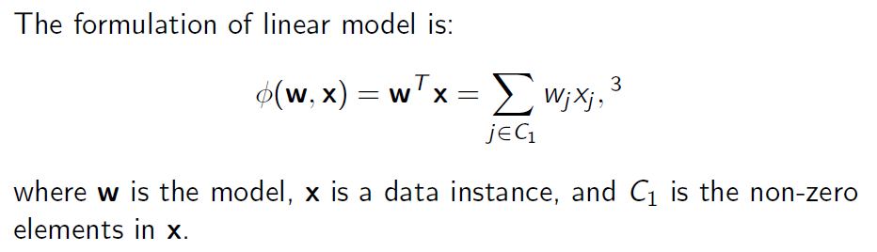
Linear Model
http://www.csie.ntu.edu.tw/~r01922136/slides/ffm.pdf

Slide 21
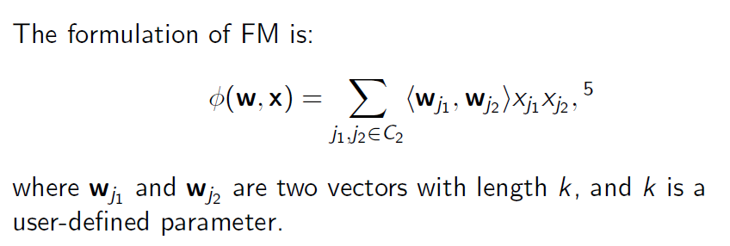
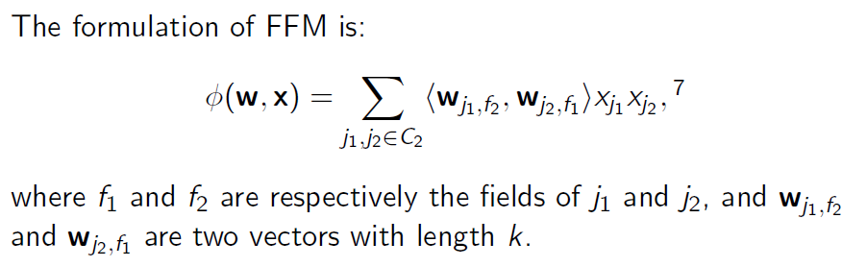
Factorisation Machines
http://www.csie.ntu.edu.tw/~r01922136/slides/ffm.pdf

